Slide 1

DATA ANALYSIS OF GENERAL ELECTION OF PARLIAMENTARY / ASSEMBLY CONSTITUENCIES:TRENDS & RESULTS- 2024
-L.SHASANK CHOWDARY

Slide 2
10 INSIGHTS FROM THE DATA SET.
STATE THE VOTE COUNT & VOTE SHARE IN PARLIAMENTARY CONSTITUENCY GENERAL.
ANALYSE THE ELECTIONS IN ANDHRA PRADESH VIA COMPARING MLA&MP SEATS.
STATE THE TOP% OF CANDIATES VIA MARGIN (MLA&MP) IN AP.
ANALYSE THE ELECTIONS IN ODISHA VIA COMPARING MLA&MP SEATS.
STATE THE TOP% OF CANDIATES VIA MARGIN (MLA&MP) IN ODISHA.
ANALYSE THE ELECTIONS IN ARUNACHAL PRADESH VIA COMPARING MLA&MP SEATS.
STATE THE TOP% OF CANDIATES VIA MARGIN (MLA&MP) IN ARUNACHAL PRADESH.

Slide 3
ANALYSE THE ELECTIONS IN SIKKIM VIA COMPARING MLA&MP SEATS.
STATE THE TOP% OF CANDIATES VIA MARGIN (MLA&MP) IN SIKKIM.
INSIGHTS ABOUT BY-ELECTIONS IN 2024.

Slide 4
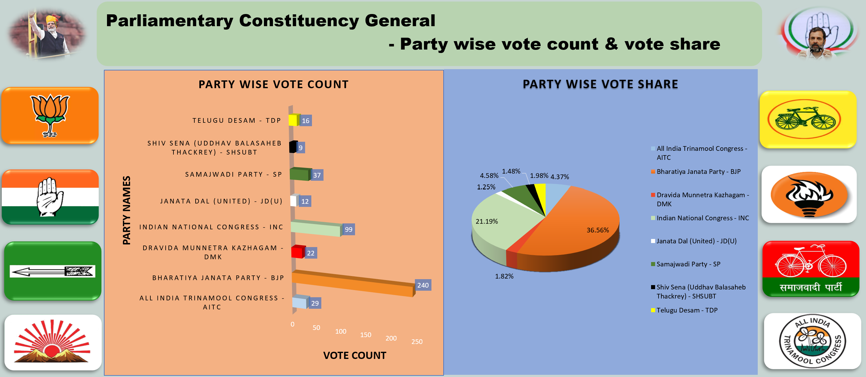
1.STATE THE VOTE COUNT & VOTE SHARE IN PARLIAMENTARY CONSTITUENCY GENERAL.

Slide 5
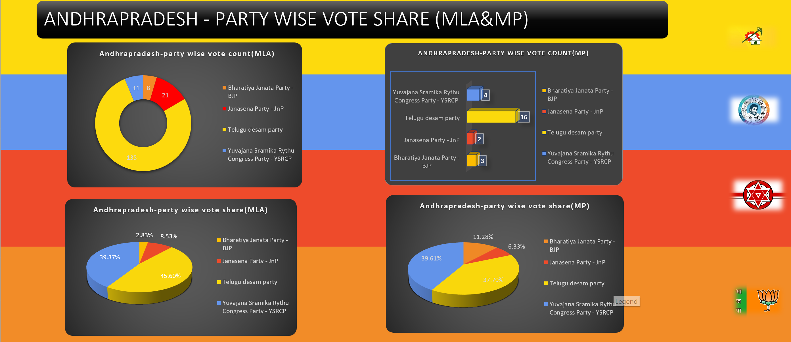
2.ANALYSE THE ELECTIONS IN ANDHRA PRADESH VIA COMPARING MLA&MP SEATS.

Slide 6
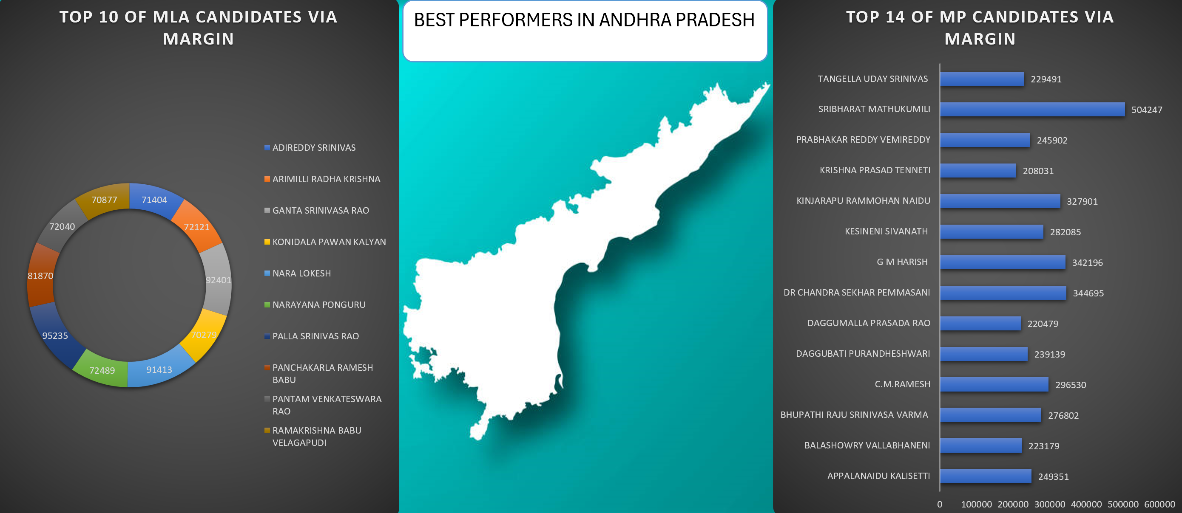
3.STATE THE TOP% OF CANDIATES VIA MARGIN (MLA&MP).

Slide 7
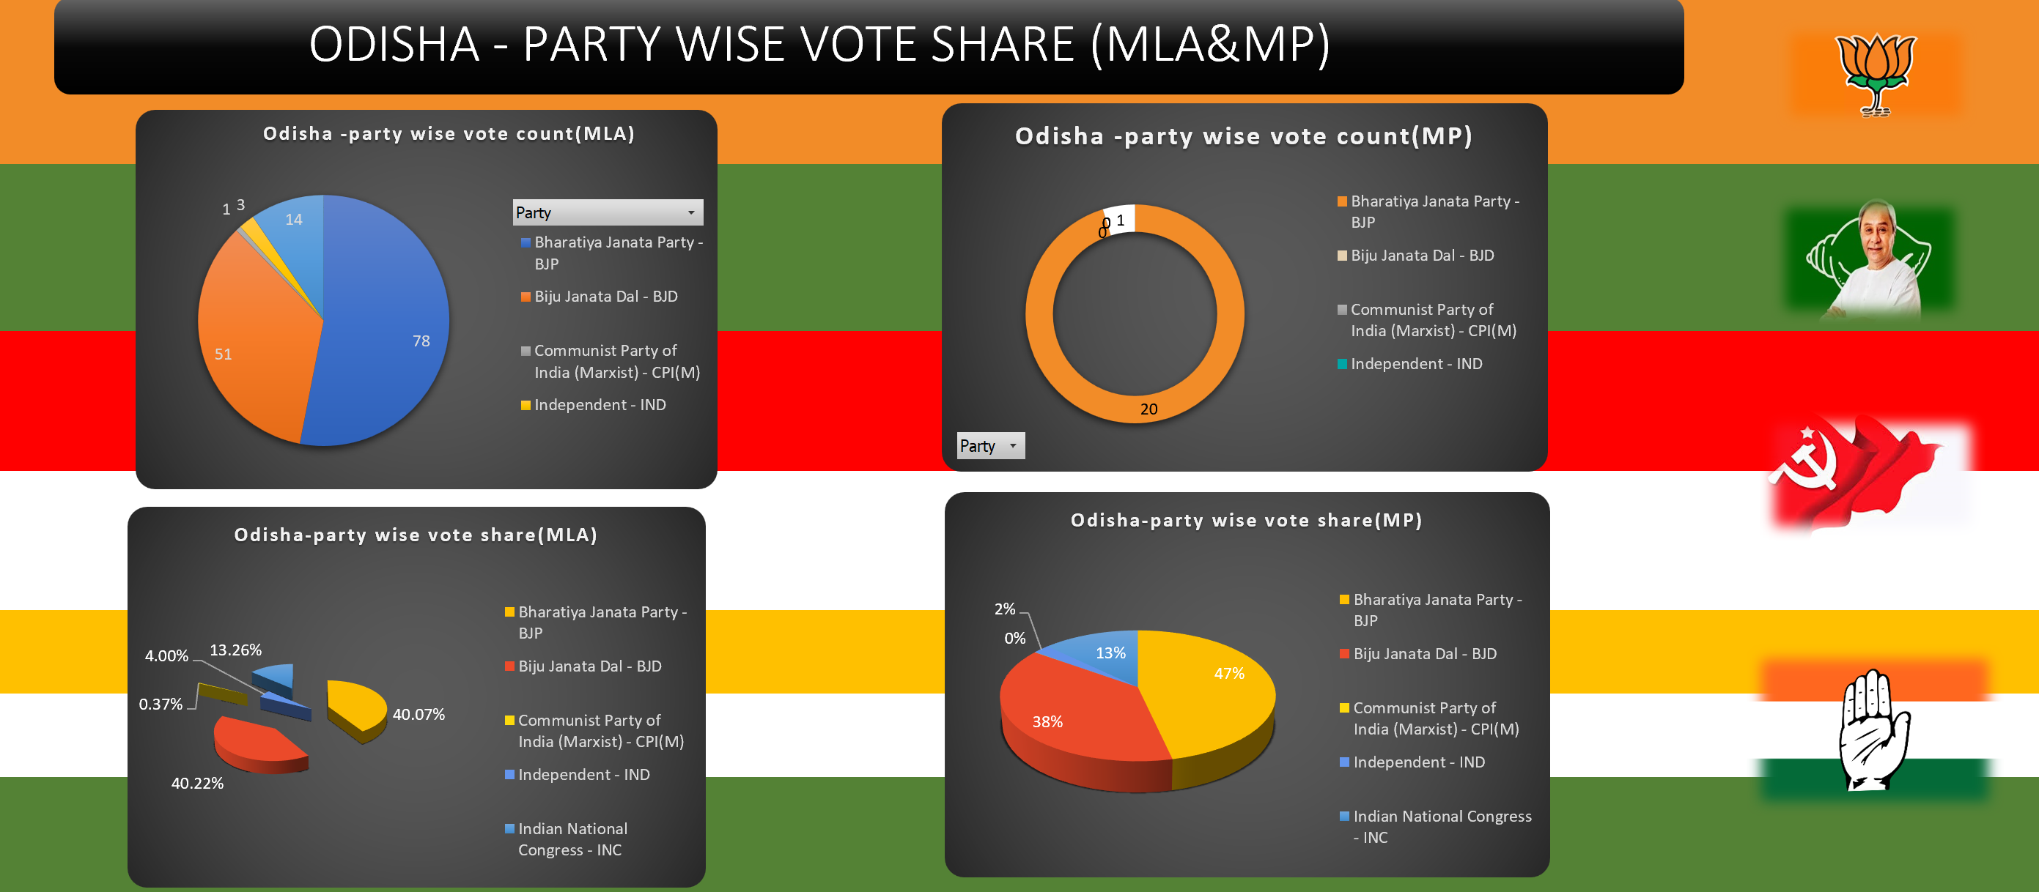
4. ANALYSE THE ELECTIONS IN ODISHA VIA COMPARING MLA&MP SEATS.

Slide 8
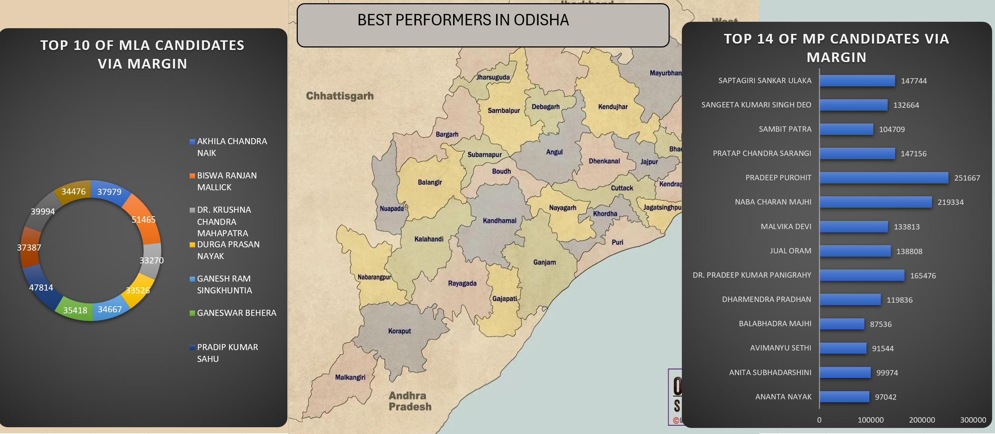
5.STATE THE TOP% OF CANDIATES VIA MARGIN (MLA&MP).

Slide 9
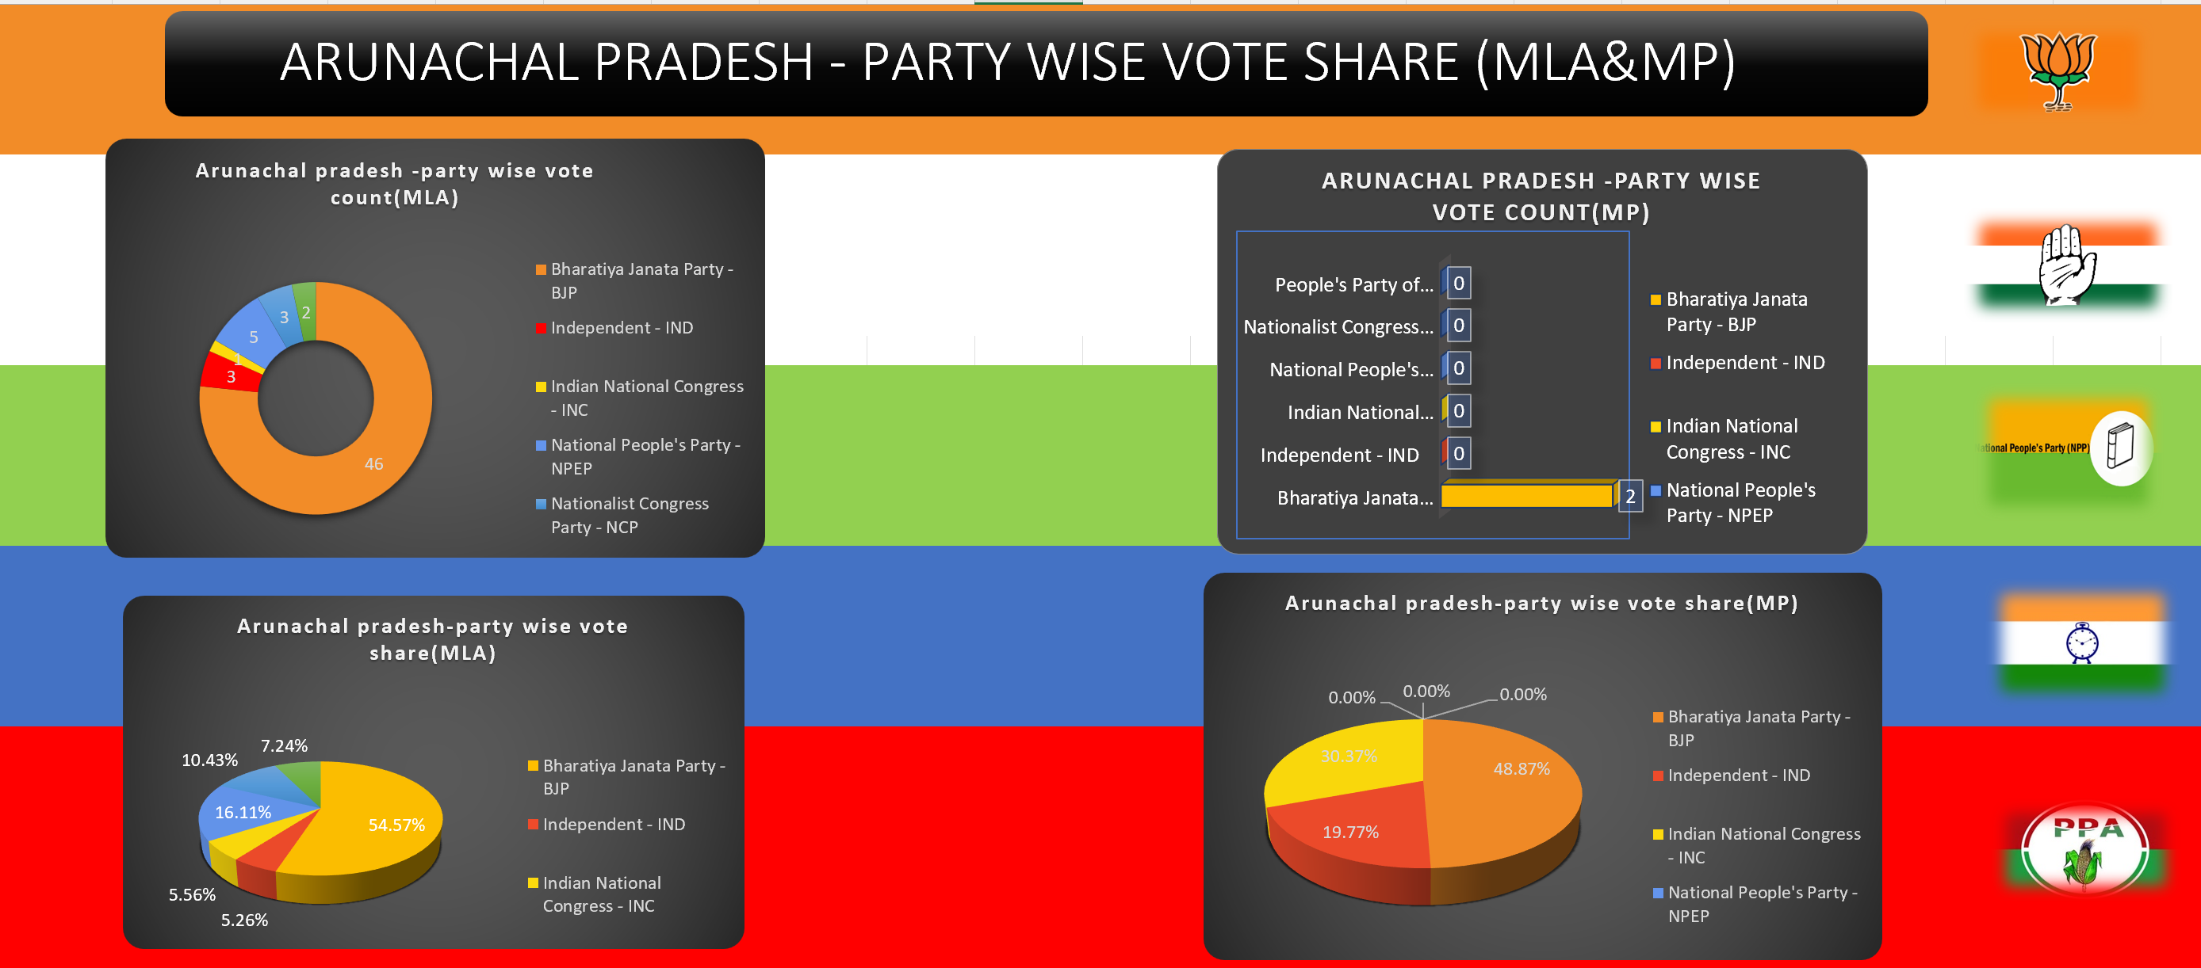
6.ANALYSE THE ELECTIONS IN ARUNACHAL PRADESH VIA COMPARING MLA&MP SEATS.

Slide 10
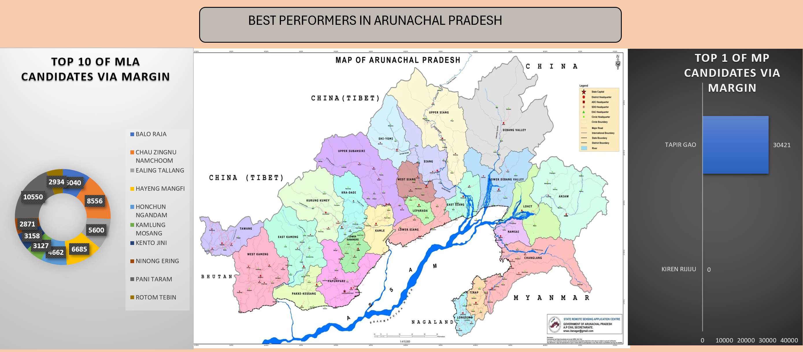
7. STATE THE TOP% OF CANDIATES VIA MARGIN (MLA&MP).

Slide 11
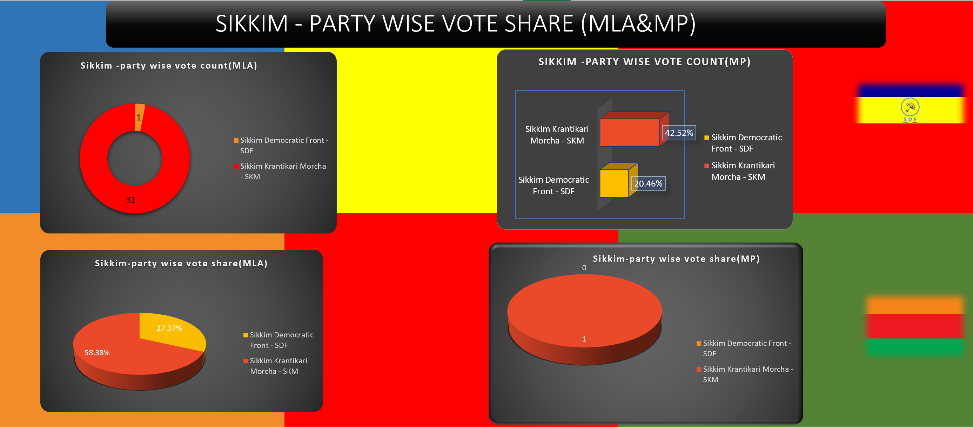
8.ANALYSE THE ELECTIONS IN SIKKIM VIA COMPARING MLA&MP SEATS.

Slide 12
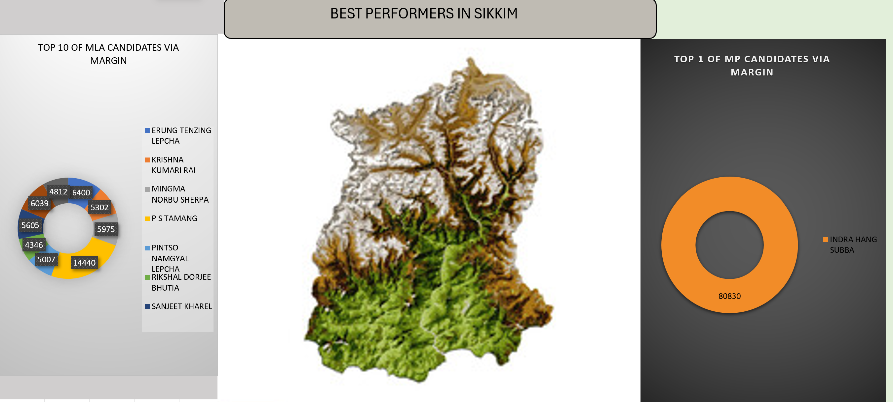
9.STATE THE TOP% OF CANDIATES VIA MARGIN (MLA&MP) IN SIKKIM.

Slide 13
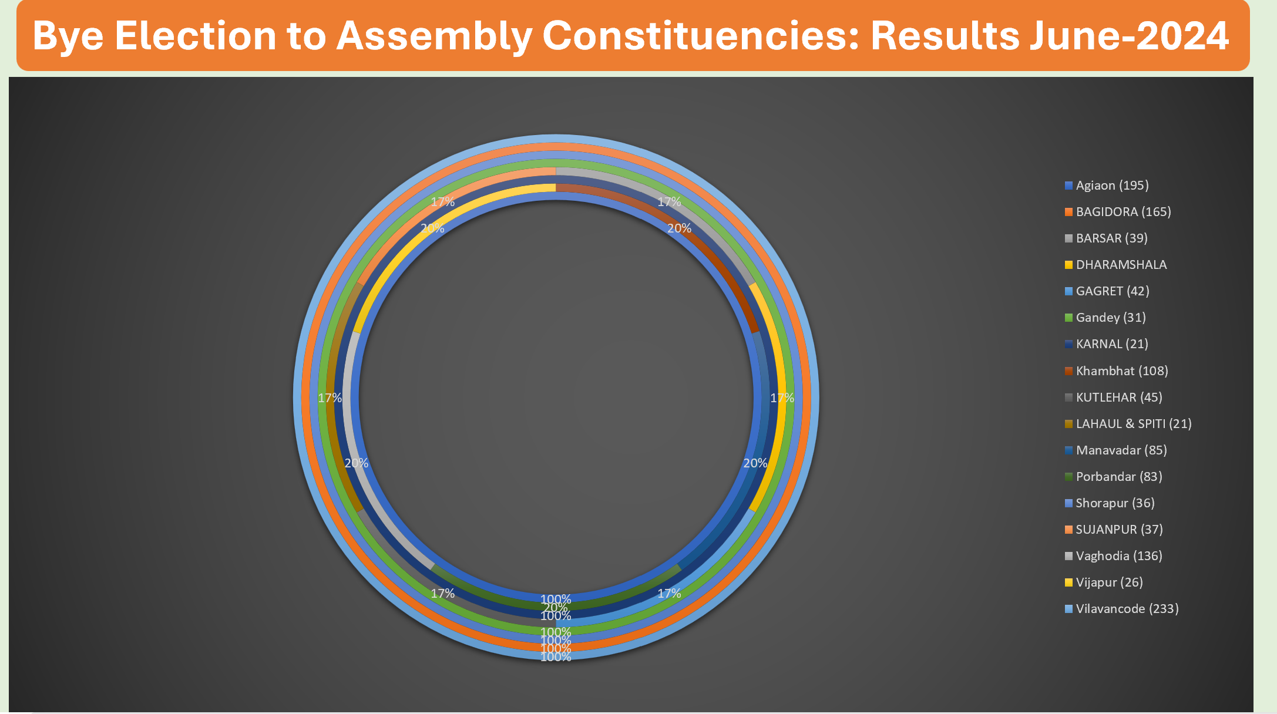
10. INSIGHTS ABOUT BY-ELECTIONS IN 2024.

Slide 14

THANK YOU

